Slide 1
Contents
Use of technology
Challenges by technology advocates.
References
Notes:
Assistive technology to children with disabilities in our day cares is not optional. The law states that they have the right to access technology in their educational institutions. “Assistive technology devices and /or services essential for a student to receive Free Appropriate Public Education (FAPE) shall be made available,” ( Edyburn, 2009). The school staff of these daycares might be reluctant about technology assistance from the government but the State is mandated to avail these devices to institutions to help the children. Daycares in my demographic are able to access some technology assistive devices and it is used more often today than in the past. This is mainly due to the intervention of the government to promote the education and functioning of the disable children. However, some AT devices are too expensive and these institutions have turned to affordable and available solutions.

Slide 2
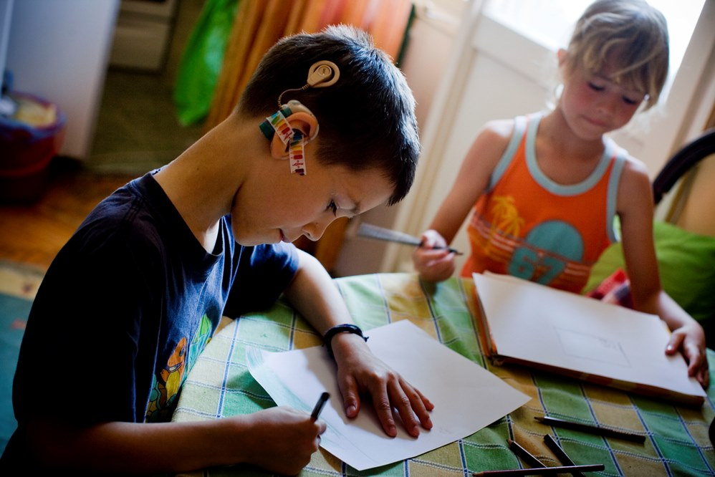
Prevalence of technology(Usage)
To communicate
To learn
Entertainment
To access information
Notes:
Children with disabilities experience major obstacles in their day to day activities. Some have problems with mobility as they cannot move freely in their environment and therefore have to be dependent on the people around them. as a result, children with disability considers and needs technology to assist them in various ways. They use the technological devices to pass message to people around. “Use of computers for communication and networking activities via the Internet can expand the learning environment beyond the walls of the classroom and allow students with disabilities, just like other students, to access and send information literally around the world,” (Hasselbring & Glaser, 2000).

Slide 3

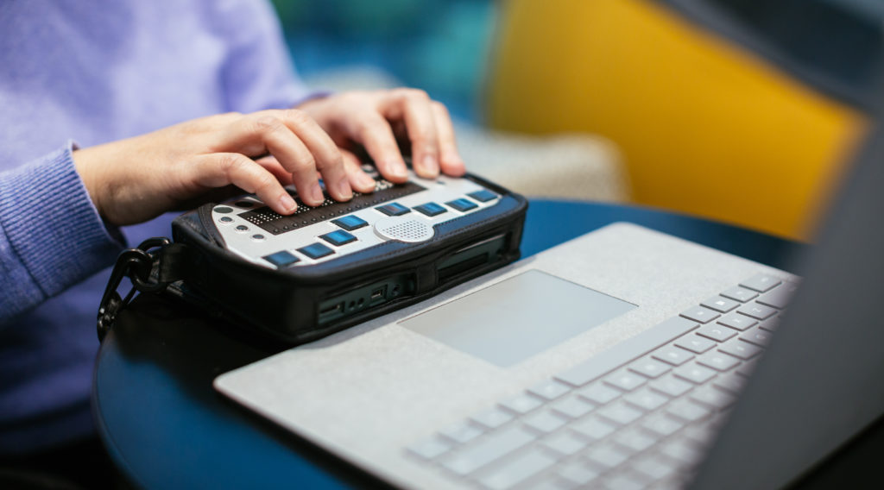
Challenges by Technology Advocates
Insufficient government support
Assessment difficulties
Inadequate trained teachers.
Inexperienced technology advocates.
Insufficient funds.
Cost of the Devices.
Time constraints.
Notes:
Individuals who advocate for assistive technology in daycares for children with disability have faced many challenges including insufficient support from the government. Provision of technological devices to disabled children is a duty mandated to the government by law. However, the government has showed little or no concerns to fulfil their role by providing funds or the devices. The advocates have also find it difficult to fully assess the AT equipment needed by an individual. Crucial aspects of the children’s ability may not receive the necessary attention at the assessment stage (Copley & Ziviani, 2004). Some teachers within the daycares are not qualified enough to handle and operate the devices provided. Lack of appropriate training for school personnel constitutes to a major for technology advocates to press for AT implementation. The high costs of AT devices and lack of support from government makes it difficult for the advocates to acquire these devices. Most daycares have weak financial purchasing power to purchase and maintain the equipment. Time is also a major barrier to the advocates in their fight to install AT devices to these institutions. For instance, a significant time is required to train the staff members, acquire the equipment, and install it before the whole set can be operational.

Slide 4
References
Copley, J., & Ziviani, J. (2004). Barriers to the use of assistive technology for children with multiple disabilities. Occupational Therapy International, 11(4); 229-243
Edyburn, D.(2009). Assistive Technology Advocacy. Special Education Technology Practice, 11(2), 15- 17
Hasselbring, T.S., & Glaser, C.H.W. (2000). Use of
computer Technology to Help Students with Special Needs. Future of Children, 10(2); 102-122

